Slide 1
Investigating the Ancient Past
Introduction to History

Slide 2
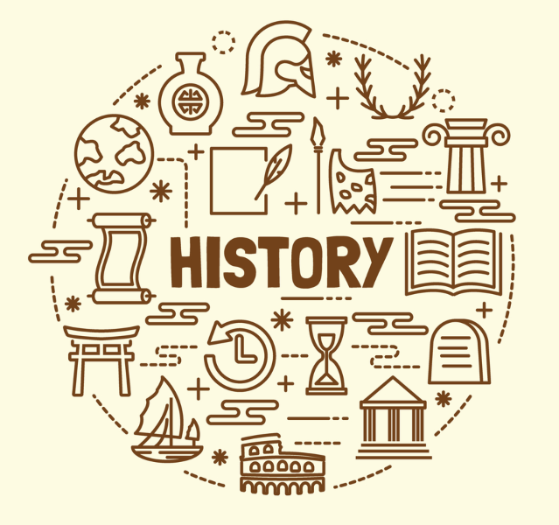
So, what is ‘History’?
On your first page of your HASS book, we will create a History Mindmap.
Place the word 'History' in the centre of your page.
Working with your peers on your table, write as many words as you can that relates to or explains what history means.
Draw symbols and pictures too to help depict 'history'.
We will then share together as a class and create a whole class history mind map using butches paper which will be displayed on the classroom wall.

Slide 3
History is the study of the past.
Historians are interested in all aspects of the past and seek to piece together what happened in that era of time.
Historians are like time detectives, following a process of historical inquiry.
They ask questions, form opinions and theories, analyse sources and use evidence to understand history.
History covers all aspects of human society.
History studies the human past as it is seen in documents and artefacts left behind.
biography
documentation
chronology
journal
life
narrative
diary
memoir
archives
autobiography
past
artefact
anthropology
primary sources
secondary sources
legend
culture
investigate
historians
ancient
medieval
era
heritage
archaeologist
inquiry
evidence
mysteries

Slide 4
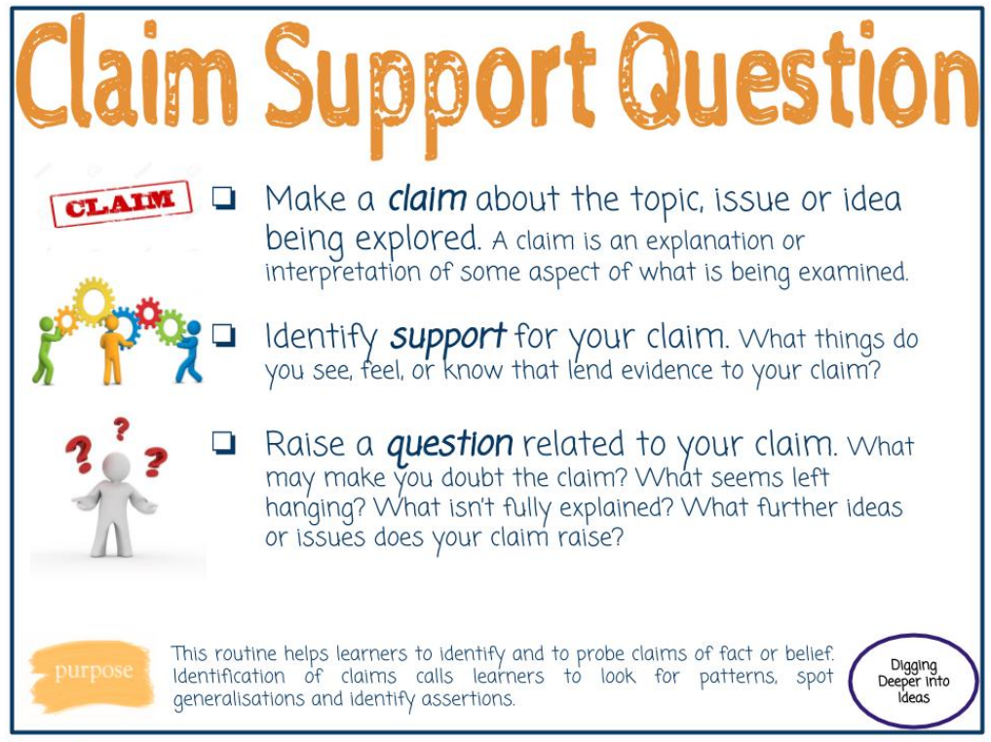

What is the value of studying history at school?
1. Is it important to study History at school? Make a claim to answer this. Try: It is (or it is not) important to study history at school.
2. Identify some support for your claim. E.g. examples of reasons why, this could be your enjoyment/ experiences of learning history, the benefits of history, how it is useful for us…
3. Come up with a question to add, what maybe isn’t explained or you would like to know to be able to make a stronger claim next time.
Share your Claim, Support, Question with your peers.
TIP: use the claim, support, question printed hand out to support you

Slide 5
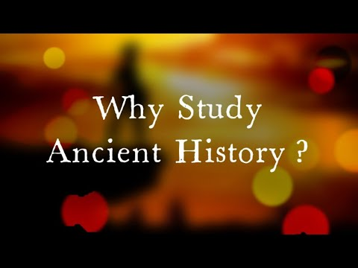

After Watching:
What words were written in this video that stated what Ancient History may be about?
What images did you see?

Slide 6
Unit Overview
This term, we will understand how evidence of the ancient past is revealed including the use of human remains to answer mysteries. We will learn how people lived in the ancient world and develop empathy for human story.
We know written history is approximately 5,500 years old therefore historians use this to compose understanding of ancient history alongside artefacts, sites and unwritten records which are much much older!
This term we will have a focus on ancient remains of people! and how this has allowed us to understand the past.
Notes:
Discuss that we understand history and what happened in the past by evidence and artefacts.
This allows us to understand how people once lived and how this links to how the world is what it is today.

Slide 7
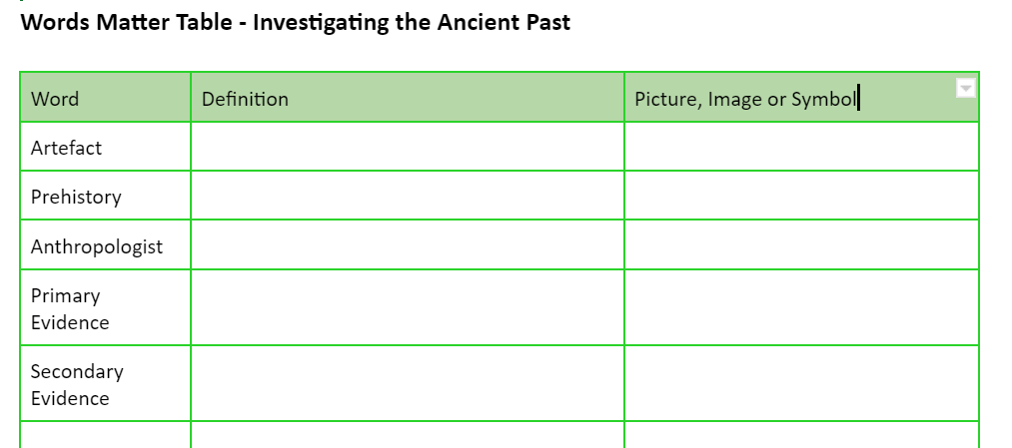

Words Matter!
TIP: Each unit we will learn new words. These are known as subject-specific vocabulary and helps us understand what we are learning.
Open 2. Words Matter - Investigating the Ancient Past Google Doc.
Using the internet, search for the definitions of the below 5 new words. Record their definitions in your own words in your table and find a picture to go with it.

